Slide 1
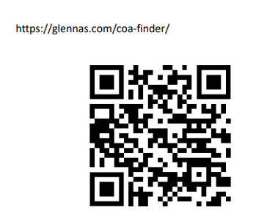
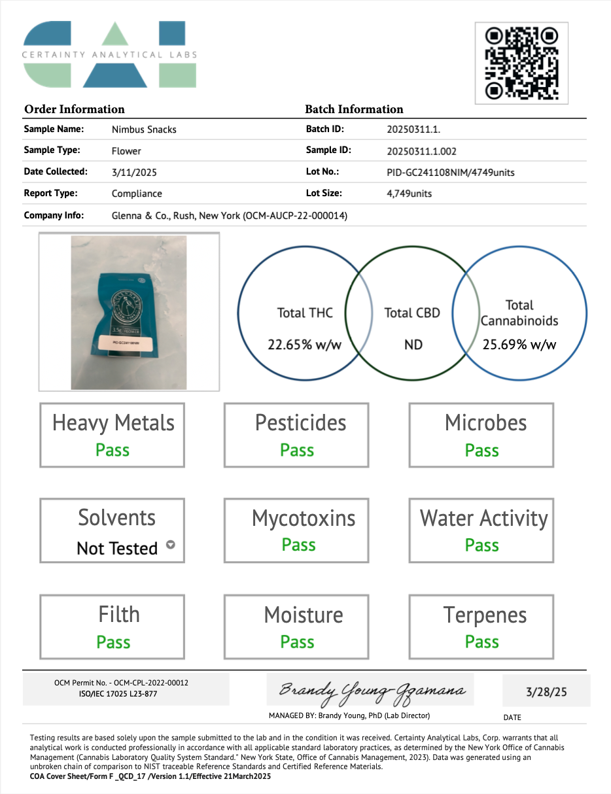
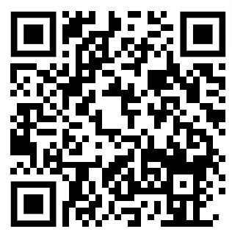
Document Number:
Title:
Form# D-FORM-LABTEST
Name: LAB TEST RESULTS
Revision Date: 1-20-23
Glenna & Co. LLC, Rush, NY
D-LABTEST – PID-GC241108NIM
LAB TESTING RESULTS
Control System: Template
Page: 1 of 5
Prepared by: TOM SKRIPPS
Effective Date: 3/28/25
https://glennas.com/wp-content/uploads/2025/3/PID-GC241108NIM.pdf

Slide 2
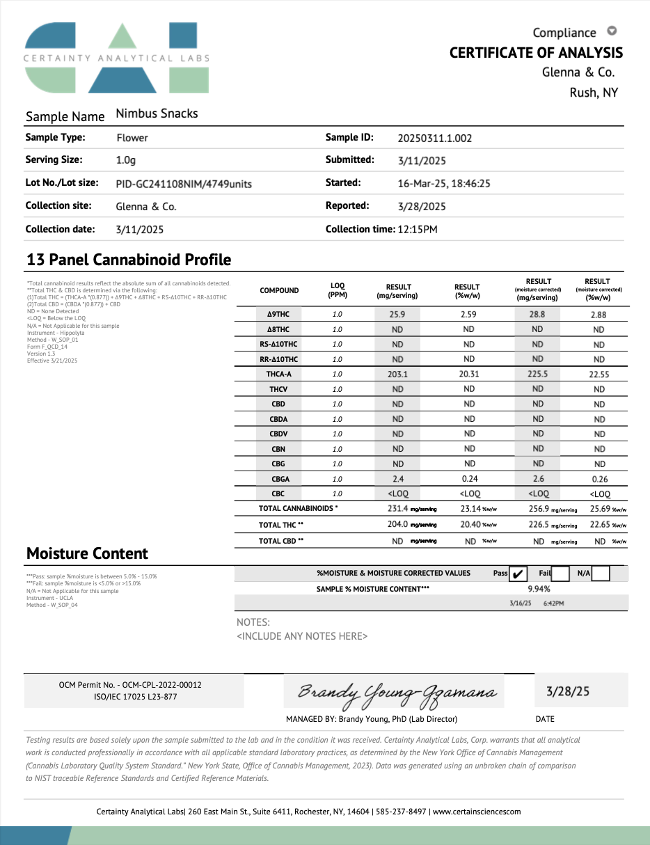
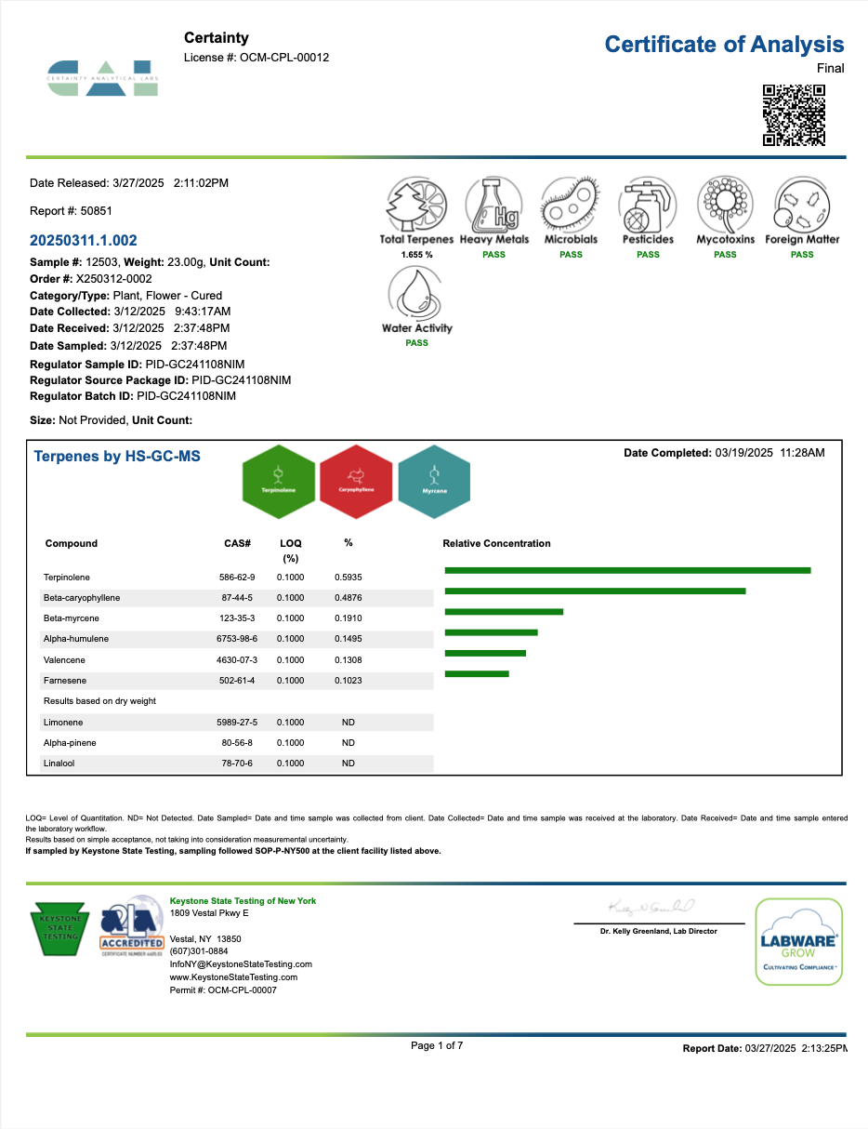
Document Number:
Title:
Form# D-FORM-LABTEST
Name: LAB TEST RESULTS
Revision Date: 1-20-23
Glenna & Co. LLC, Rush, NY
D-LABTEST – PID-GC241108NIM
LAB TESTING RESULTS
Control System: Template
Page: 2 of 5
Prepared by: TOM SKRIPPS
Effective Date: 3/28/25

Slide 3
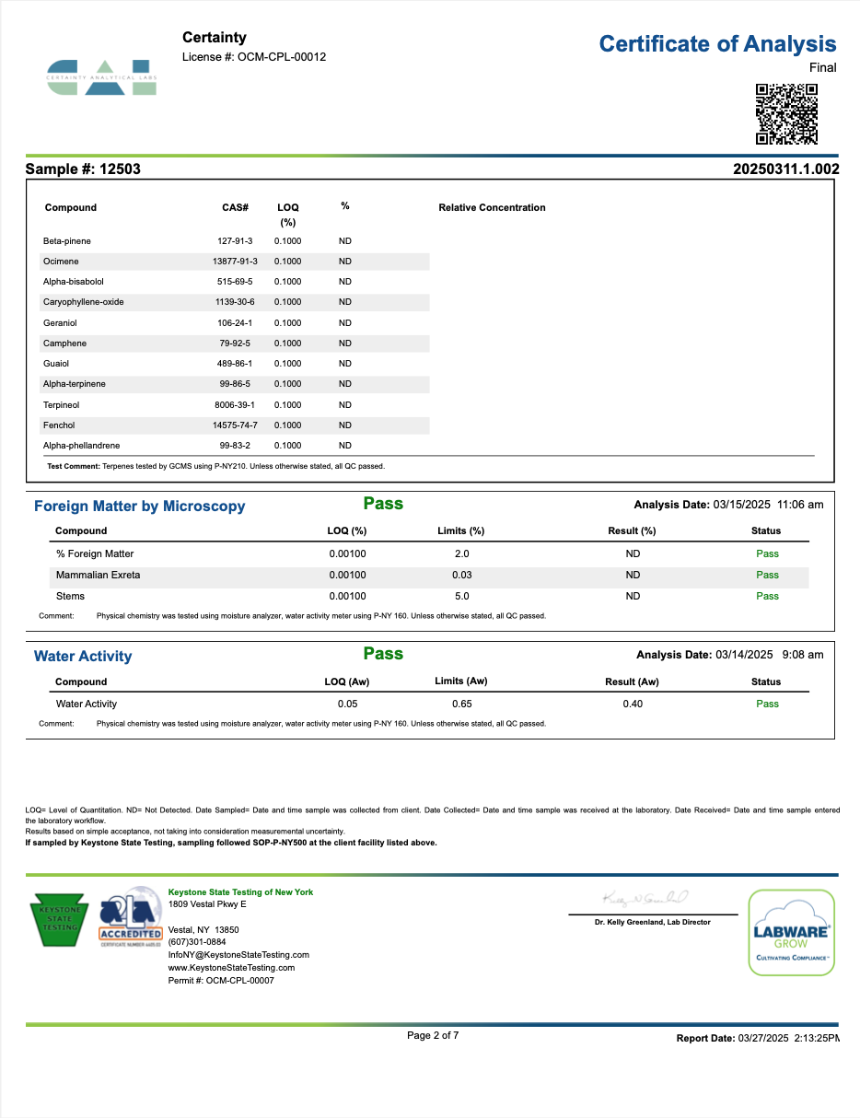
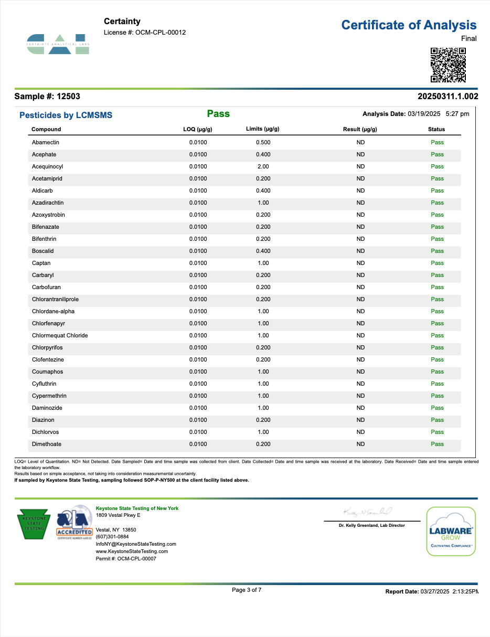
Document Number:
Title:
Form# D-FORM-LABTEST
Name: LAB TEST RESULTS
Revision Date: 1-20-23
Glenna & Co. LLC, Rush, NY
D-LABTEST – PID-GC241108NIM
LAB TESTING RESULTS
Control System: Template
Page: 3 of 5
Prepared by: TOM SKRIPPS
Effective Date: 3/28/25

Slide 4
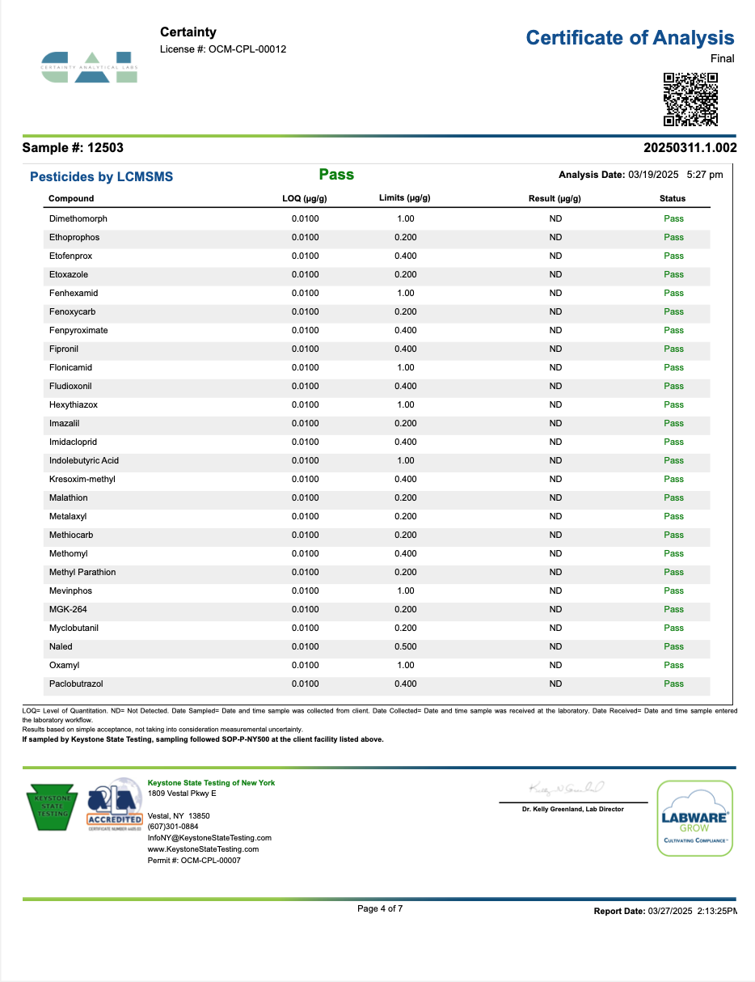
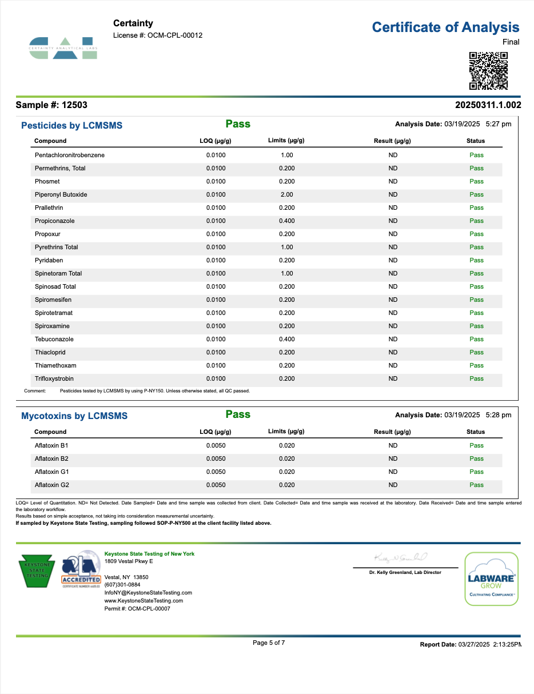
Document Number:
Title:
Form# D-FORM-LABTEST
Name: LAB TEST RESULTS
Revision Date: 1-20-23
Glenna & Co. LLC, Rush, NY
D-LABTEST – PID-GC241108NIM
LAB TESTING RESULTS
Control System: Template
Page: 4 of 5
Prepared by: TOM SKRIPPS
Effective Date: 3/28/25

Slide 5
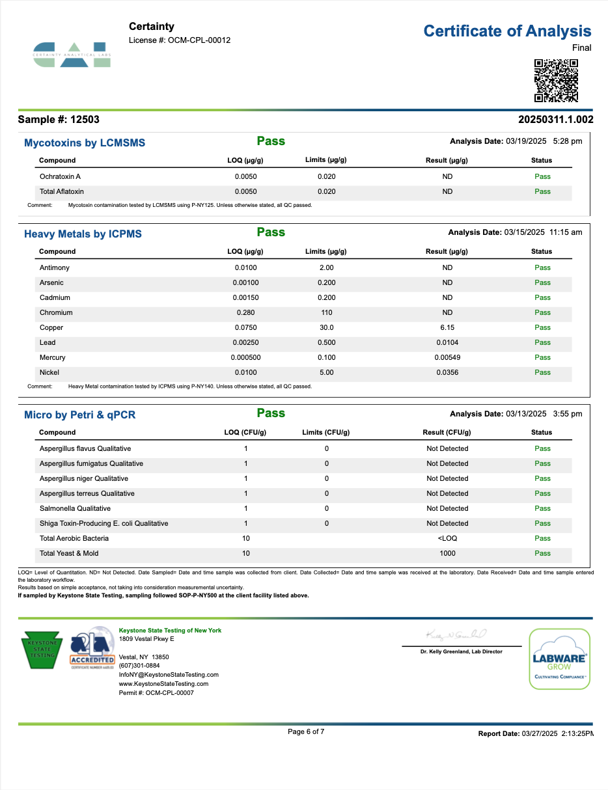
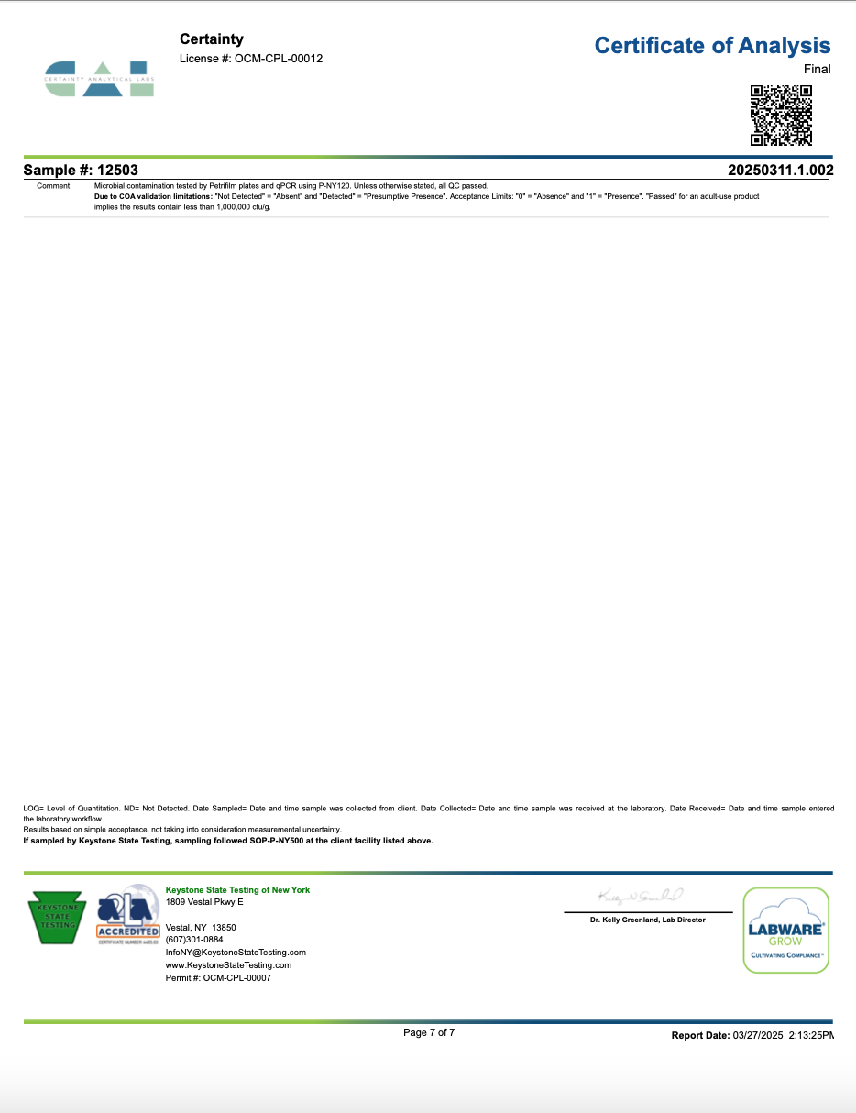
Document Number:
Title:
Form# D-FORM-LABTEST
Name: LAB TEST RESULTS
Revision Date: 1-20-23
Glenna & Co. LLC, Rush, NY
D-LABTEST – PID-GC241108NIM
LAB TESTING RESULTS
Control System: Template
Page: 5 of 5
Prepared by: TOM SKRIPPS
Effective Date: 3/28/25

